Slide 1
What are mental models? A mental model is an explanation of how something works. The phrase “mental model” is an overarching term for any sort of concept, framework, or worldview that you carry around in your mind.
Mental models help you understand life. For example, supply and demand is a mental model that helps you understand how the economy works. Game theory is a mental model that helps you understand how relationships and trust work.

Slide 2
Mental models also guide your perception and behavior. They are the thinking tools that you use to understand life, make decisions, and solve problems. Learning a new mental model gives you a new way to see the.

Slide 3
Mental models are imperfect, but useful. There is no single mental model from physics or engineering, for example, that provides a flawless explanation of the entire universe, but the best mental models from those disciplines have allowed us to build bridges and roads, develop new technologies, and even travel to outer space.

Slide 4
The best mental models are the ideas with the most utility. They are broadly useful in daily life. Understanding these concepts will help you make wiser choices and take better actions. This is why developing a broad base of mental models is critical for anyone interested in thinking clearly, rationally, and effectively.

Slide 5
They are the beliefs that a user holds about any given system or interaction. In most instances, the belief will – to a certain extent – resemble the real-life model. This is important because users will plan and predict future actions within a system based on their mental models.

Slide 6
Mental models play an important role in Human-Computer Interaction (HCI) and interaction design. They relate to the way that a user perceives the world around them and are based in belief as opposed to being a factual concept. However, if you can understand your users' mental models, you can simulate these models within your designs to make them more usable and intuitive.

Slide 7
Designers can tap into users mental models so that their products communicate their function through their form. However, they can only do this successfully if they truly understand their users' mental models.

Slide 8
It is an all too common failing of designs for designers to base their ideas on their own mental models; their models are often too complete and detailed to bear any relationship with a user’s model. This in turn leads to failure in UI where the user does not find their mental model and is left confused and frustrated.

Slide 9
It is worth noting that a mental model is not a static creation. It is capable of evolution and may change based on using other products, from interacting with other users or taking on board learning from other sources.

Slide 10
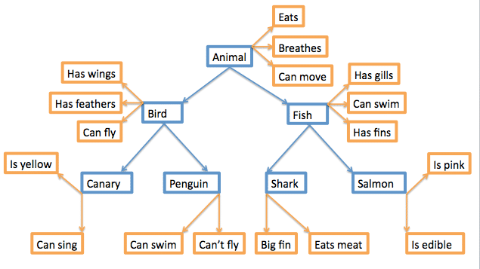
The Mental Model Rule of Thumb

Slide 11
Confused Mental Models
He observes that many users seem unable to distinguish between the search field on Google and the URL entry field in a browser. These users will use Google to search for the name of a well-known website in order to click the link rather than simply entering the name plus “.com” in the URL bar.

Slide 12
Taking Advantage of Mental Models in Design

Slide 13
User interface (UI) and user experience (UX) are two words that you might hear mentioned frequently in tech circles (and sometimes interchangeably). But what do the terms actually mean, and what does it mean to be a UX or UI designer?
UI refers to the screens, buttons, toggles, icons, and other visual elements that you interact with when using a website, app, or other electronic device.
UX refers to the entire interaction you have with a product, including how you feel about the interaction. While UI can certainly have an impact on UX, the two are distinct, as are the roles that designers play.

Slide 14
Think about the first thing you do when you pick up a new mobile phone or click on a new website. Do you have a certain expectation when you swipe across the mobile screen or scan the navigation at the top of the webpage for the first time?
If you answered yes, that means you have a mental model of how those user interfaces work. When we engage with the world, our brains are constantly organizing the information we encounter into cognitive representations, which are called mental models.

Slide 15
When it comes to UX design, one of the biggest goals for any project should be to uncover users’ mental models. Understanding your users’ mental models will help you make design choices that will be intuitive and engaging for them.

Slide 16
1. What is a mental model?
“what the user believes about the system at hand.”
In other words, a mental model is what a user thinks they know about how to use a website, mobile phone, or other digital product. Mental models are built in a user’s brain and people reference them to make their lives easier.
By referring to what they already know from their past interactions with another weather app, for example, the user can streamline their interactions with a new weather app. They’ll know approximately where to look for the current temperature, the forecast, and how to add the forecasts for other cities and states with minimal cognitive effort.
As long as the new app more or less matches the interaction patterns and information architecture of a familiar app, the user will quickly become comfortable with the new weather app.

Slide 17
2. What’s included in users’ mental models (and what’s not)
If you don’t adhere to user’s existing mental models, there will be a mismatch between the user’s idea of how a product will work and the way it actually works. This mismatch can cause all sorts of problems because it will lead to user frustration, and often, users will abandon your app or website, or decide against buying your mobile phone or tablet.

Slide 18
For example, if a person is going to a new website to buy something, they will have a mental model of how the check out experience on the new website will work based on their past experiences with online shopping. If the new check out sequence is consistent with their mental model, the user will smoothly navigate through it and feel satisfied with their experience.

Slide 19
3. Use mental models to create UX that makes sense
UX designers shouldn’t assume their mental models are the same as those of their users. It’s important to remember that each individual’s mental models are subjective. People pay attention to different things, have different levels of comfort, and have varied requirements when it comes to the digital tools they use.

Slide 20
This doesn’t mean UX designers should avoid innovative design solutions entirely. Our mental models can evolve and expand. However, changing our mental models takes a lot more work than simply going with the tried and true. So, when a user encounters a product that pushes back against their mental models, they may resist, get frustrated, and give up.
As a result, new UX solutions should be introduced sparingly. More often than not, UX designers should conform to users’ existing mental models to ensure their expectations are met and their experiences with your latest design are as smooth as possible. That’s why understanding users’ existing mental models is essential when designing a new UI.

Slide 21
4. How to determine users’ existing mental models
Understanding the way your system works with users’ mental models enables designers to create more intuitive and satisfying user experiences. Plus, user testing can help uncover any discrepancies between a user’s mental models and the way a UI works, so you as the UX designer can correct any issues before the product is released.
Another tactic that can be used in conjunction with user research (or in lieu of it if you have a limited budget) is competitor research. Competitor research is valuable because it enables you to see the way competitors’ systems are designed and infer what users are comfortable with as a result.

Slide 22
5. How to fix a mental model mismatch
Despite a UX designer’s best efforts, sometimes there is a mismatch between the user’s mental model and a product’s UI that lead the user to make mistakes. If the system can be changed, the solution is simple: make sure it conforms to users’ mental models.

Slide 23
6. Key Takeaways
In the context of UX design, a mental model is what the user believes about how a user experience works.
Mental models are built in a user’s brain and are based on what they know from past interactions with websites, mobile phones, and other interactive products.
UX designers can use mental models to develop designs that will make sense to users.
New usability innovations should be introduced sparingly.
If a mismatch exists between users’ mental models and a product’s UX, it will result in mistakes and user frustration.
Determine users’ existing mental models through user and competitor research.
If a mismatch exists between users’ mental models and a new UI, change the system to conform to users’ mental models or, if that’s not possible or desired, include instructions, tutorials, and demos to educate users about how the system works.

